Slide 1
Toll Choice Modeling for North Carolina Statewide Model Update
Sumit Bindra
June 4, 2019

Slide 2
Acknowledgement
North Carolina DOT
Staff at RSG
Staff at CDM Smith

Slide 3
Context
North Carolina’s project prioritization process for transportation funding
  legislatively mandated
  largely quantitative
  statewide model plays a key role
Recently, the state has begun building tolled facilities
  Triangle Expressway (traditional toll road)
  I-77 Express Lanes (HOT lanes)
Notes:
In order to fairly evaluate these types of projects, the statewide model needed to be updated to incorporate toll modeling.

Slide 4
Tolling / Express Lanes
GOAL
  Add ability to test traditional tolled highways and express lanes
  Need to be able to reasonably predict metrics such as travel time savings, volume-to-capacity, etc., for project prioritization
  Although theoretically possible, revenue forecasting not recommended
RELIABILITY
  Growing evidence showing this is major factor in express lane use
  Not enough time to incorporate in short term improvements
Notes:
Didn’t we rescale to 0% error? If so, we should update all of this.

Slide 5
Toll Modeling Methodologies
(recommended for short term)
BINARY TOLL CHOICE WITH TOLL ELIGIBLE & INELIGIBLE CLASSES
  Most common method
  Reflects distribution of VOT
  Generally produce reasonable results, esp. for traditional toll roads
  Can have problems with competing toll paths – express lanes
  May cause schedule delay of 2-4 weeks
MULTICLASS ASSIGNMENT WITH DISCRETIZATION OF VOT
  Easier to implement, calibrate
  Reflects distribution of VOT
  Generally produce reasonable results
  May provide better results for express lanes
  Would require machines with 32 GB of RAM
Notes:
Didn’t we rescale to 0% error? If so, we should update all of this.

Slide 6
Values of Time (Trucks)
META-ANALYSIS
  Limited data from one NC survey showing very low VOTs ($14-21/hr)
  Meta-analysis suggests reasonable values $30-45/hr for multi-unit trucks ($20-30/hr for single unit)
  P4 assumption for monetizing truck travel time savings was $75/hr
Source | Heavy Trucks | Medium and/or Light Trucks
Smalkowski & Levinson, 2005 | 60.90
Outwater & Kitchen, 2008 | 55.89 | 44.71
Miao et al., 2011 | 35.57-60.43
Almy et al., 2010 | 47.32
Mei et al., 2010 | 34.89-54.73 | 27.31-48.36
RSG (Tampa-Jacksonville), 2013 | 35.20-42.53 | 25.84-28.76
BLA, EDRG & RSG (Ohio DOT), 2013 | 37.79 | 23.33-28.55
Kawamura, 1999 | 33.80
RSG (Connecticut I-84), 2013 | 32.27 | 11.32
RSG (Columbia River Crossing), 2012 | 31.64 | 18.11
Kawamura, 2003 | 23.02-36.62
ATRI, 2015 (driver time & benefits only) | 23.61
Notes:
Didn’t we rescale to 0% error? If so, we should update all of this.

Slide 7
Values of Time (Autos)
AVAILABLE DATA
  Three stated preference surveys (Triangle Expressway, 2007, 4,745 surveys; Monroe Expressway, 2009, 878 surveys; Garden Parkway, 2010, 1,151 surveys)
  Average VOTs $9-14/hr
  Reasonably consistent with US DOT guidance, prioritization process
Notes:
Didn’t we rescale to 0% error? If so, we should update all of this.

Slide 8
Toll Choice Modeling – Specification & Segmentation
In each stated preference scenario, the following two alternatives were presented for making a future trip in the area
  Current toll-free route with a travel time
  Toll route with a shorter travel time and an associated toll
  Toll route with a shorter travel time and an associated toll (Monroe Connector only)
The multinomial logit model estimates a choice probability for each alternative presented in the stated preference tradeoff exercises
In addition to travel time and toll cost, other tested variables included:
  Time of day (peak or off-peak period)
  Day of week (weekends or weekdays)
  Trip purpose
  Trip start and end locations (home based or non-home based)
  Project opinion
  Household income
  Trip distance
Mixed multinomial logit model was used as the final product

Slide 9
Toll Choice Modeling
This VOT distributions estimated from the surveys were applied to the NCSTM and used to divide auto trips in to five market segments with the following average VOTs:
PeakVOT | OffPeakVOT | Avg. Auto VOT
3.28 | 3.22 | 3.24
7.15 | 7.08 | 7.11
12.29 | 12.21 | 12.24
19.53 | 19.41 | 19.46
38.58 | 36.37 | 37.28

Slide 10
Toll Choice Modeling
Similarly, five market segments were developed for muti-unit trucks and three for single unit trucks.
Single Unit Truck VOT | Multi Unit Truck VOT
20.52 | 12.57
38.79 | 31.12
56.75 | 49.54
- | 67.95
- | 88.34

Slide 11
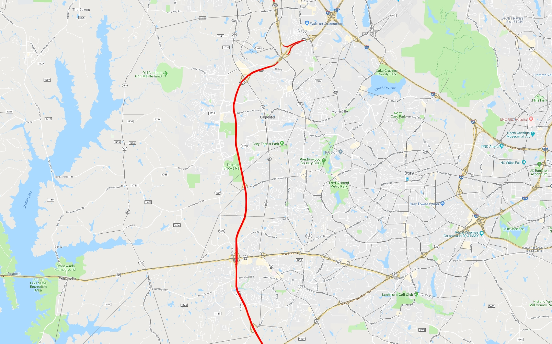
Toll Choice Modeling - Calibration
The toll model was calibrated for volumes on the Triangle Expressway.
This was done by adding a calibration constant to scale up the travel time savings of toll roads to account for travel time reliability, and other factors ignored in this version of the model

Slide 12
Model Update Task
The goal of this project was to improve upon the existing North Carolina statewide model
Some of the enhancements were:
  Improve run time and streamline TC macros
  Improve handling of external long-distance model
  Improve traffic assignment with focus on toll choice modeling (focus of this presentation)
Currently working on:
  updating the base year,
  incorporating hybrid tour-based elements such as linking HB and NHB trips, and
  incorporating passive big data.

Slide 13
Sumit Bindra
Consultant
Sumit.Bindra@rsginc.com
802-295-4999

